Slide 1

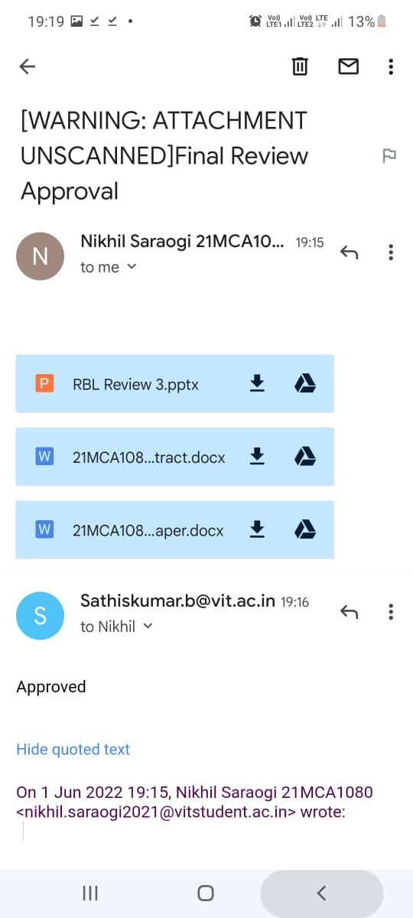
Guide approval :-
VIT - CHENNAI

Slide 2

SCHOOL OF COMPUTER SCIENCE AND ENGINEERING M.C.A. (MASTER IN COMPUTER APPLICATION) 21st SET Conference Under the Guidance of DR. SATHIS KUMAR B
RBL SET 5002
Project – ad or non-ad prediction
Presenter – Nikhil Saraogi 21MCA1080
VIT - CHENNAI

Slide 3
Description:-
These data are from the paper Learning to remove Internet advertisements . The dataset represents a set of possible advertisements on Internet pages. The attributes encode the geometry of the image (if available) as well as phrases occurring in the URL, the image's URL and alt text, the anchor text, and words occurring near the anchor text. There are two class labels: advertisement ("ad") and not advertisement ("nonad"). The interesting fact about this data is that someone might wish to filter the WebPages from irrelevant advertisements, as part of some preprocessing procedure (e.g. useful for subsequent classification of the website).
VIT - CHENNAI

Slide 4
Data size :-
Attributes: The data has 1558 attributes (3 continous; others binary;) One or more of the three continous features are missing in 28% of the instances. It has height, width, aspect ratio and local: 19 caption features, 111 alt features, 495 base URL features, 472 destination URL features, and 457 inmage URL features.
Number of records: The data has 3279 instances (2821 nonads, 458 ads).
VIT - CHENNAI

Slide 5
Task :-
Prepare the data for mining and perform an exploratory data analysis. The data mining task is to predict whether an image is an advertisement ("ad") or not ("nonad"). As I am not given an explicit training/test split you need to decide on a reasonable way of assessing performance. Perform feature reduction in order to significantly reduce the number of features.
VIT - CHENNAI

Slide 6
Challenges:-
There is an imbalance in the number of instances for each classes. Also the number of attributes are very high in comparison to the size of the dataset, which suggests that efficient feature reduction is very important. One or more of the three continuous features are missing in 28% of the data.
VIT - CHENNAI

Slide 7
Classifiers :-
K Nearest Neighbors
Gaussian NB
SVM
Random Forest
AdaBoost Classifier
Gradient Boosting
Decision Tree
Logistic Regression
XG Boost
VIT - CHENNAI

Slide 8
K-Nearest Neighbours
non-linear prediction boundaries as it’s a non-linear classifier
Predicts the class of a new test data point by finding its k nearest neighbours' class.
you’d have to count the number of data points present in different categories, and you’d assign the new data point to the category with the most neighbors.
RESULTS
F-score: 99.1319%
Mean: 96.4929%
Standard Deviation: 0.6542%
Accuracy: 98.4756%
VIT - CHENNAI

Slide 9
2) Gaussian Naive Bayes
Gaussian Naive Bayes is a variant of Naive Bayes that follows Gaussian normal distribution and supports continuous data
. It doesn't require as much training data.
It handles both continuous and discrete data.
It is highly scalable with the number of predictors and data points.
It is fast and can be used to make real-time predictions
RESULTS
F-score: 97.7586%
Mean: 94.9290%
Standard Deviation: 0.7261%
Accuracy: 96.0366%
VIT - CHENNAI

Slide 10
3) SUPPORT VECTOR MACHINE [SVM]
represents the training data in space differentiated into categories by large gaps
useful in high dimensional spaces and is quite memory efficient because it only employs a subset of training points in its decision function.
MODEL – SVM1-LINEAR
F-score: 98.1132%
Mean: 94.8148%
Standard Deviation: 0.9841%
Accuracy: 96.6463%
VIT - CHENNAI

Slide 11
4.) Logistic Regression :-
Supervised learning classification algorithm
Great tool for analyzing binary and categorical data
Independent variable is used to predict the dependent variable
Used to predict the probability of a target variable.
Use Sigmoid Function for probability
Data set should be free of missing value.
VIT - CHENNAI

Slide 12
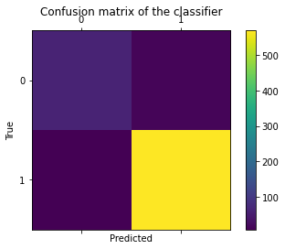
Prediction – logistic regression
RESULTS
F-score: 98.1067%
Mean: 94.8145%
Standard Deviation: 0.8757%
Accuracy: 96.6463%
VIT - CHENNAI

Slide 13
5.) Decision Tree :-
Supervised learning technique
It is a tree-structured classifier, where internal nodes represent the features of a dataset, branches represent the decision rules and each leaf node represents the outcome.
It is a graphical representation for getting all the possible solutions to a problem/decision based on given conditions.
Uses Entropy and Information Gain to construct a decision tree
VIT - CHENNAI

Slide 14

Prediction – Decision tree
RESULTS
F-score: 99.6534%
Mean: 95.9593%
Standard Deviation: 0.8711%
Accuracy: 99.3902%
VIT - CHENNAI

Slide 15
6.) random forest :-
Supervised Machine Learning Algorithm that is used widely in Classification and Regression problems.
Based on the concept of ensemble learning, which is a process of combining multiple classifiers to solve a complex problem and to improve the performance of the model.
Builds decision trees on different samples and takes their majority vote for classification and average in case of regression.
The greater number of trees in the forest leads to higher accuracy and prevents the problem of over-fitting.
VIT - CHENNAI

Slide 16

Prediction – Random forest
RESULTS
F-score: 99.6540%
Mean: 96.9508%
Standard Deviation: 0.8323%
Accuracy: 99.3902%
VIT - CHENNAI

Slide 17
7.) Adaboost :-
Boosting is an ensemble modeling technique (1997)
AdaBoost is short for Adaptive Boosting and is a very popular boosting technique that combines multiple “weak classifiers” into a single “strong classifier”.
Create base learner sequentially
Remove errors after base learner modeling
Base estimator (Decision tree , SVC)
VIT - CHENNAI

Slide 18

Prediction – adaboost
RESULTS
F-score: 97.7021%
Mean: 95.7680%
Standard Deviation: 0.4004%
Accuracy: 95.8841%
VIT - CHENNAI

Slide 19
8) gradient Boosting
Used for predicting not only continuous target variable (as a Regressor) but also categorical target variable (as a Classifier)
In gradient boosting, each predictor corrects its predecessor’s error.
As gradient boosting is one of the boosting algorithms it is used to minimize bias error of the model.
This algorithm is to find the best value of n_estimators.
Objective here is to minimize this loss function by adding weak learners using gradient descent
VIT - CHENNAI

Slide 20
Prediction – gradient Boosting
RESULTS
F-score: 99.13%
Mean: 97.10%
Standard Deviation: 0.484%
Accuracy: 98.4756%
VIT - CHENNAI

Slide 21
9) MLP
MLPClassifier stands for Multi-layer Perceptron classifier which in the name itself connects to a Neural Network.
The advantages of Multi-layer Perceptron are:
Capability to learn non-linear models.
Capability to learn models in real-time (on-line learning) using partial_it.
MLP with hidden layers have a non-convex loss function where there exists more than one local minimum. Therefore different random weight initializations can lead to different validation accuracy.
VIT - CHENNAI

Slide 22
Prediction – mlp
RESULTS
F-score: 99.04%
Mean: 96.56%
Standard Deviation: 0.762%
Accuracy: 98.32%
VIT - CHENNAI

Slide 23
RESULT:-
Classifier | Accuracy | F-Score | Mean | Standard Deviation
Knn | 98.47% | 99.13% | 96.49% | 0.65%
SVM | 96.64% | 98.11% | 94.81% | 0.98%
Gaussian NB | 96.03% | 97.75% | 94.92% | 0.72%
Logistic Regression | 96.64% | 98.10% | 94.81% | 0.875%
Decision Tree | 99.39% | 99.65% | 95.95% | 0.871%
Random Forest | 99.39% | 99.65% | 96.95% | 0.832%
AdaBoost | 95.88% | 97.70% | 95.76% | 0.400%
Gradient Boosting | 98.47% | 99.13% | 97.10% | 0.484%
MLP | 98.32% | 99.04% | 96.56% | 0.762%
VIT - CHENNAI

Slide 24

VIT - CHENNAI

